Slide 1



Slide 2





















•
•

Slide 3






Slide 4














Slide 5















Slide 6
















Slide 7





Slide 8




Slide 9



Slide 10



Slide 11



Slide 12


Slide 13


Slide 14



Slide 15


Slide 16








Slide 17


Slide 18


Slide 19



Slide 20


Slide 21



Slide 22


Slide 23




Slide 24





Slide 25



















•
•
•
•

Slide 26




Slide 27





Slide 28
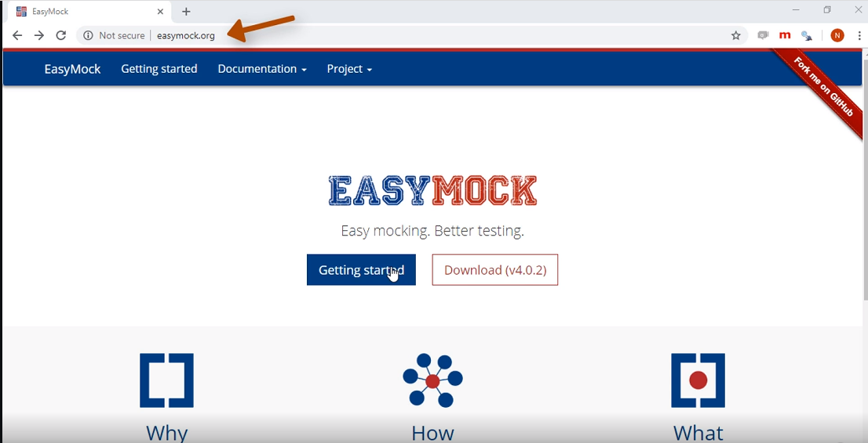

Slide 29
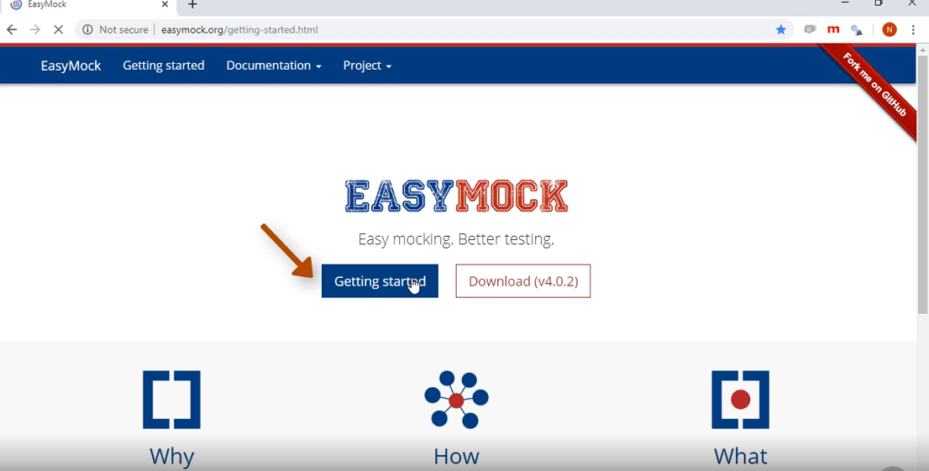

Slide 30
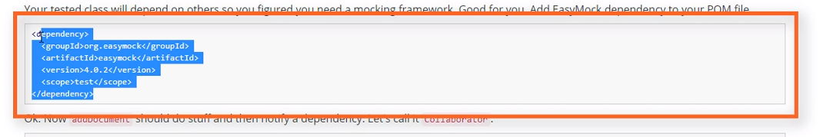

Slide 31




Slide 32












Slide 33










Slide 34










Slide 35




Slide 36











Slide 37








Slide 38




Slide 39







Slide 42





Slide 43




private AccountOpeningService
underTest;
private BackgroundCheckService backgroundCheckService =
mock(BackgroundCheckService.class);
private ReferenceIdsManager referenceIdsManager =
mock(ReferenceIdsManager.class);
private AccountRepository accountRepository =
mock(AccountRepository.class);
@BeforeEach
void setUp() {
underTest = new AccountOpeningService(
backgroundCheckService,
referenceIdsManager,
accountRepository);
}

Slide 44
private AccountOpeningService underTest;
private BackgroundCheckService backgroundCheckService =
mock(BackgroundCheckService.class);
private ReferenceIdsManager referenceIdsManager =
mock(ReferenceIdsManager.class);
private AccountRepository accountRepository =
mock(AccountRepository.class);
@BeforeEach
void setUp() {
underTest = new AccountOpeningService(
backgroundCheckService,
referenceIdsManager,
accountRepository);
}

Slide 45
private AccountOpeningService underTest; private BackgroundCheckService backgroundCheckService = mock(BackgroundCheckService.class); private ReferenceIdsManager referenceIdsManager =
 | new ExternalNationalReferenceIdsManager(…);
private AccountRepository accountRepository = mock(AccountRepository.class); @BeforeEach void setUp() { underTest = new AccountOpeningService( backgroundCheckService, referenceIdsManager, accountRepository); }

Slide 46


private AccountOpeningService
underTest;
private BackgroundCheckService backgroundCheckService =
mock(BackgroundCheckService.class);
private ReferenceIdsManager referenceIdsManager =
new ExternalNationalReferenceIdsManager(…);
private AccountRepository accountRepository =
mock(AccountRepository.class);
@BeforeEach
void setUp() {
underTest = new AccountOpeningService(
backgroundCheckService,
referenceIdsManager,
accountRepository);
}

Slide 47








Slide 48
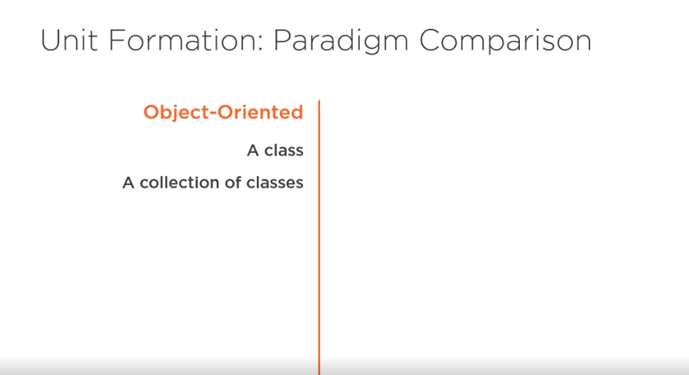

Slide 49









Slide 50





•
•

Slide 51


Slide 52




BackgroundCheckService
backgroundCheckService =
◀
mock(BackgroundCheckService.class);
ReferenceIdsManager
referenceIdsManager =
◀
mock(ReferenceIdsManager.class);
◀
AccountRepository
accountRepository =
◀
mock(AccountRepository.class);

Slide 53





private AccountOpeningService
underTest;
private BackgroundCheckService backgroundCheckService =
mock(BackgroundCheckService.class);
private ReferenceIdsManager referenceIdsManager =
mock(ReferenceIdsManager.class);
private AccountRepository accountRepository =
mock(AccountRepository.class);
@BeforeEach
void setUp() {
underTest = new AccountOpeningService(
backgroundCheckService,
referenceIdsManager,
accountRepository);
}

Slide 54













accountRepository.save( id,
firstName, lastName, taxId, dob,
◀
◀
backgroundCheckResults);
◀

Slide 55




-

Slide 56








